Slide 1
CSE- 105 Structure Programming
Lecture 9
Loop : break, continue and exit

Slide 2
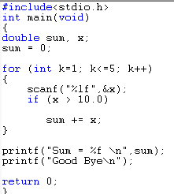
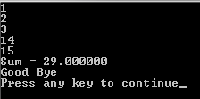
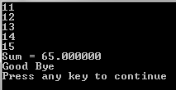
Loop
Notes:
break;
terminates loop
execution continues with the first statement following the loop

Slide 3


break statement
break;
terminates loop
execution continues with the first statement following the loop
If the condition is true
Jump out of the loop
Notes:
break;
terminates loop
execution continues with the first statement following the loop

Slide 4


break statement
sum += x;
will never execute, WHY?
Notes:
break;
terminates loop
execution continues with the first statement following the loop

Slide 5
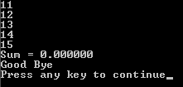
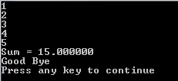
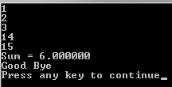
continue statement
continue;
forces next iteration of the loop, skipping any remaining statements in the loop
If the condition is true go to the next iteration
Notes:
break;
terminates loop
execution continues with the first statement following the loop

Slide 6
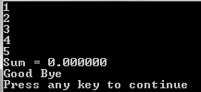
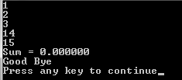
continue statement
sum += x;
Also never execute here, WHY?
Notes:
break;
terminates loop
execution continues with the first statement following the loop

Slide 7
Example: A man walks
Suppose a man (say, A) stands at (0, 0) and waits for user to give him the direction and distance to go.
User may enter N E W S for north, east, west, south, and any value for distance.
When user enters 0 as direction, stop and print out the location where the man stopped
N
W
E
S

Slide 8
float x=0, y=0;
char direction;
float mile;
while (1) {
printf("Please input the direction as N,S,E,W (0 to exit): ");
scanf("%c", &direction); fflush(stdin);
if (direction=='0'){ /*stop input, get out of the loop */
break;
}
if (direction!='N' && direction!='S' && direction!='E' && direction!='W') {
printf("Invalid direction, re-enter \n");
continue;
}
printf("Please input the mile in %c direction: ", direction);
scanf ("%f",&mile); fflush(stdin);
if (direction == 'N'){ /*in north, compute the y*/
y+=mile;
} else if (direction == 'E'){ /*in east, compute the x*/
x+=mile;
} else if (direction == 'W'){ /*in west, compute the x*/
x-=mile;
} else if (direction == 'S'){ /*in south, compute the y*/
y-=mile;
}
}
printf("\nCurrent position of A: (%4.2f,%4.2f)\n",x,y); /* output A's location */

Slide 9
Example: what will be the output
int main()
{
int a, b, c;
a=5;
while(a > 2) {
for (b = a ; b < 2 * a ; b++ ) {
c = a + b;
if (c < 8) continue;
if (c > 11) break;
printf( “a = %d b = %d c = %d \n”, a, b, c);
} /* end of for-loop */
a--;
} /* end of while loop */
}
a = 5 b = 5 c = 10
a = 5 b = 6 c = 11
a = 4 b = 4 c = 8
a = 4 b = 5 c = 9
a = 4 b = 6 c = 10
a = 4 b = 7 c = 11
a = 3 b = 5 c = 8

Slide 10
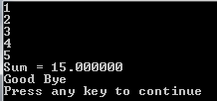
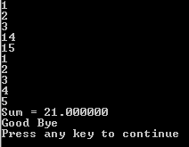
goto statement
Z :
If the condition is true goto label Z
Notes:
break;
terminates loop
execution continues with the first statement following the loop

Slide 11

goto statement
If the condition is true goto label Z,
Which is now actually out of loop
Z :
Notes:
break;
terminates loop
execution continues with the first statement following the loop

Slide 12
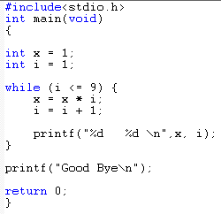
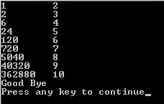
Exercise
Design the following code using goto and if-else only, i.e., no while or for loop

Slide 13
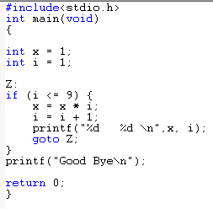
Exercise
Design the following code using goto and if-else only, i.e., no while or for loop

Slide 14
Exercise
Design the following code using goto and if-else only, i.e., no while or for loop

Slide 15
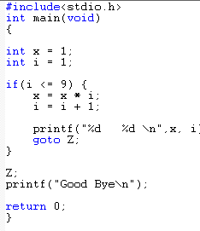

Exercise
What will be the output now ?
Z:

Slide 16
Cautions
Avoid goto as much as possible
Reduce Programme readability
use COMMENTS, if goto is extremely required
// or /**/
For the termination you can also use exit() functions
which requires a #include<stdlib.h>
exit(0) → normal programme terminations

Slide 17
Summary
It will end our loop lectures.
There will two labs on it lab 4 and 5.
However you can’t solve any problem in the up-comming labs (Lab 3-11) without loop

